Slide 1

Email Spam Classifier
Presented by: Group 32
1. Shobhana Verma (MSD23006)
2. Kashish Chhabra (MSD23001)
3. Sahil Bhardwaj (MSD23009)
4. Ranjan Das (MSD23012)

Slide 2
1
INTRODUCTION
Objective: Build a classifier that accurately distinguishes spam from non-spam emails.
Datasets: Merged from multiple Kaggle sources.
Methods Used: Text preprocessing, feature engineering, model training, and handling data imbalance

Slide 3
2
PROJECT GOALS
Develop a reliable, accurate classifier.
Standardize and clean email text data.
Engineer features to improve model performance.
Handle class imbalance effectively.
Train multiple models and tune for optimal accuracy.

Slide 4
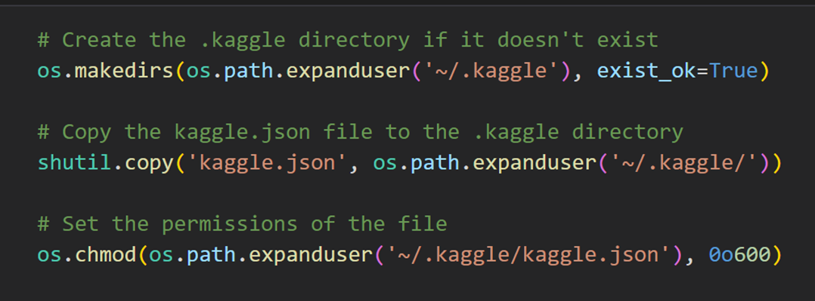
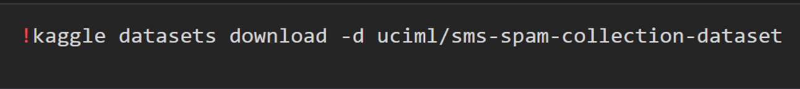
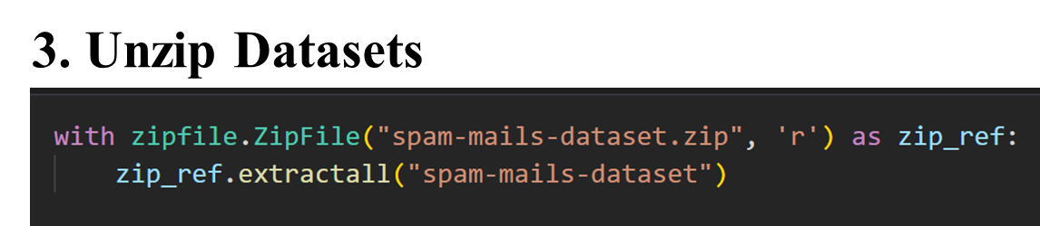
Kaggle Directory
3
Similarly, We performed the same process for all 4 datasets.
Download dataset
Unzip datasets
Larana University | 2024

Slide 5
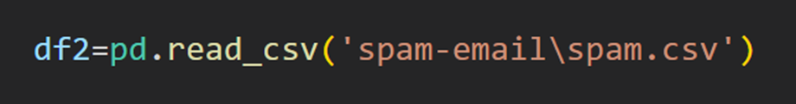
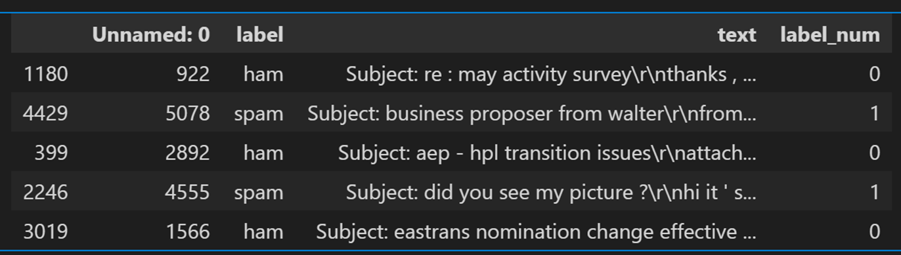
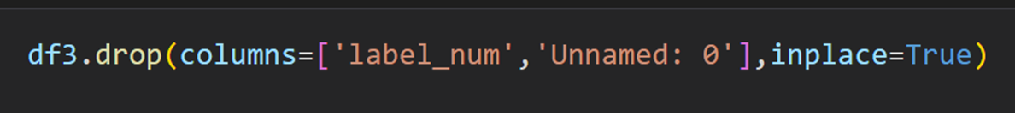
Create a data frame
4
Data Frame
Drop Column

Slide 6
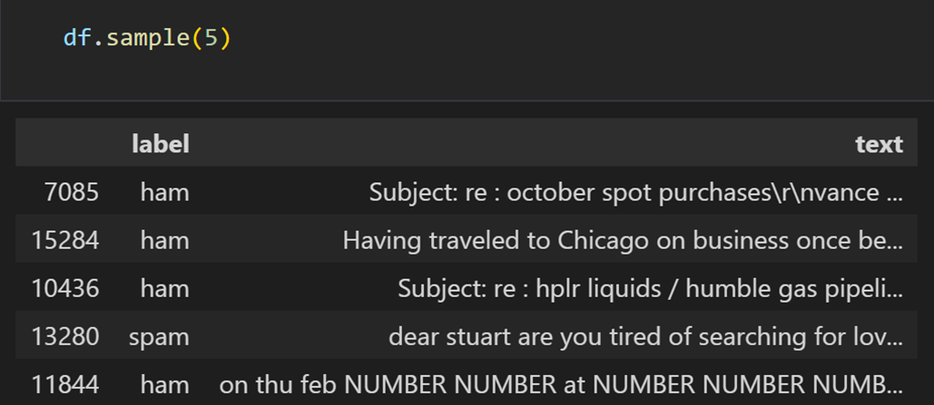
Combined Dataset
5
Sample Data

Slide 7
6
Data Preprocessing
1.Lower case conversion for consistency,
2.Whitespace and newline removal,
3.Removal of stopwords (keep essential ones like “not” and “but”),
4.Lemmatization for word consistency,
5.Cleaning out URLs, email addresses, and HTML tags
HTML Tags Removal
Newline Removal:

Slide 8
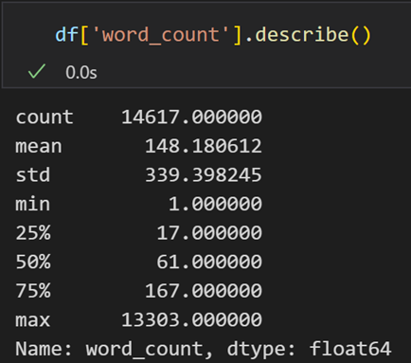
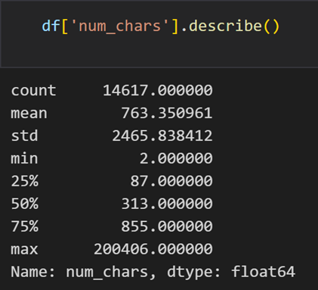
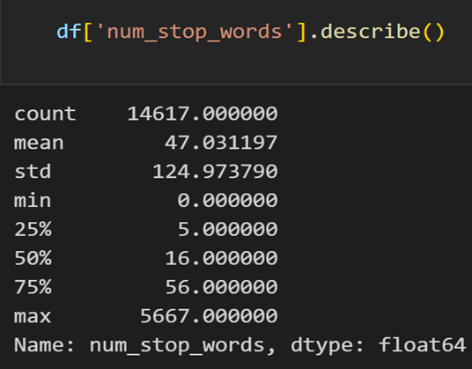
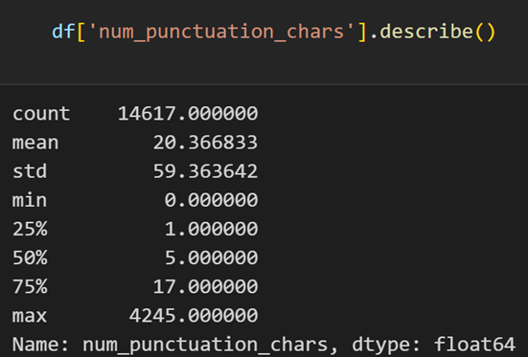
7
Feature Engineering
•Word Count: Before and after cleaning.
•Character Count: Measures text length before and after cleaning.
•Stopwords Count: Total count before and after removal.
•Punctuation Count: Captures punctuation as a feature.

Slide 9
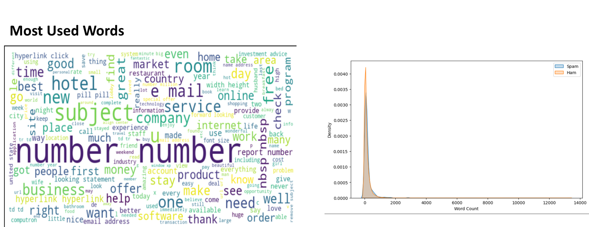
8
EXPLORATOTY DATA ANALYSIS
Most Used words Word count disambiguation by category

Slide 10
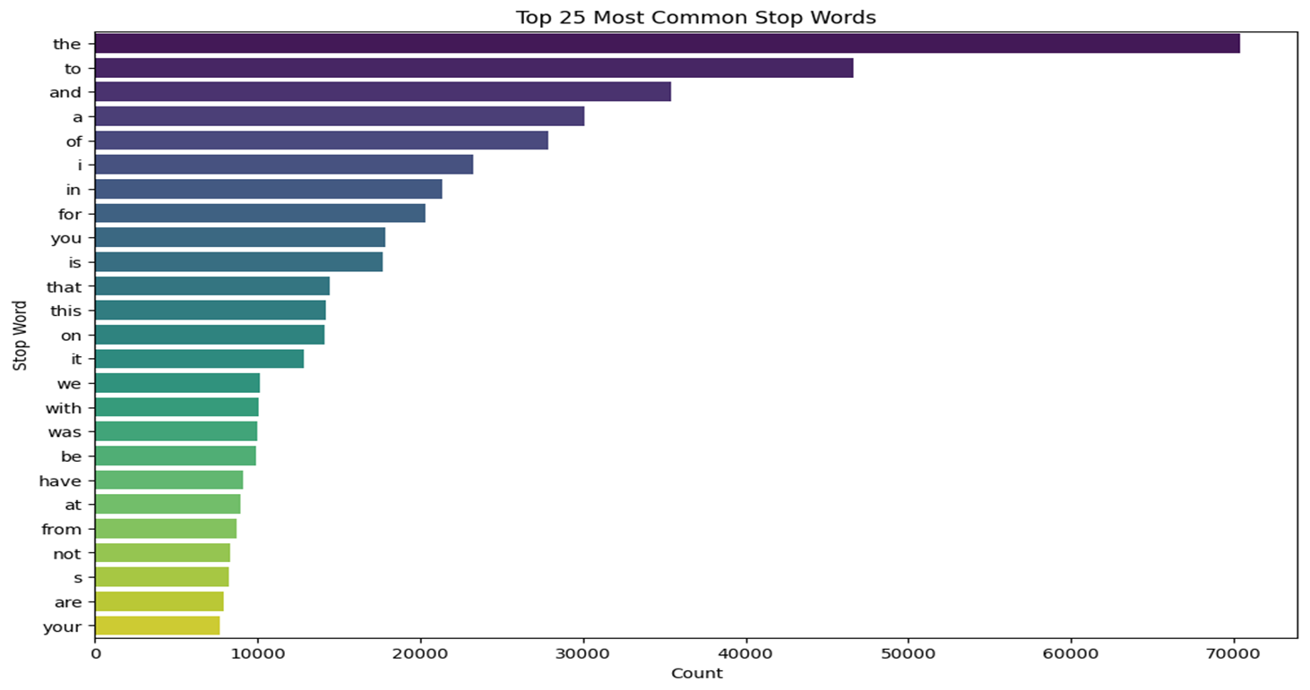
9
Top 25 Common Stop Words

Slide 11
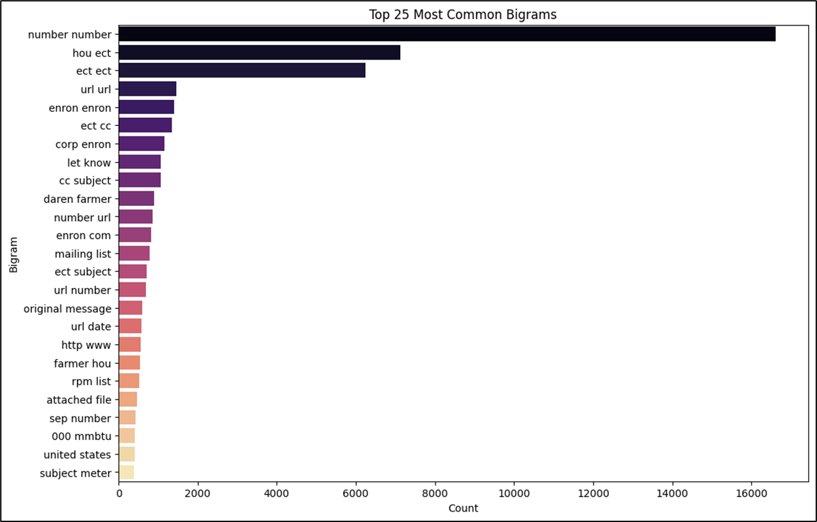
10
Top 25 Common Bi-grams

Slide 12
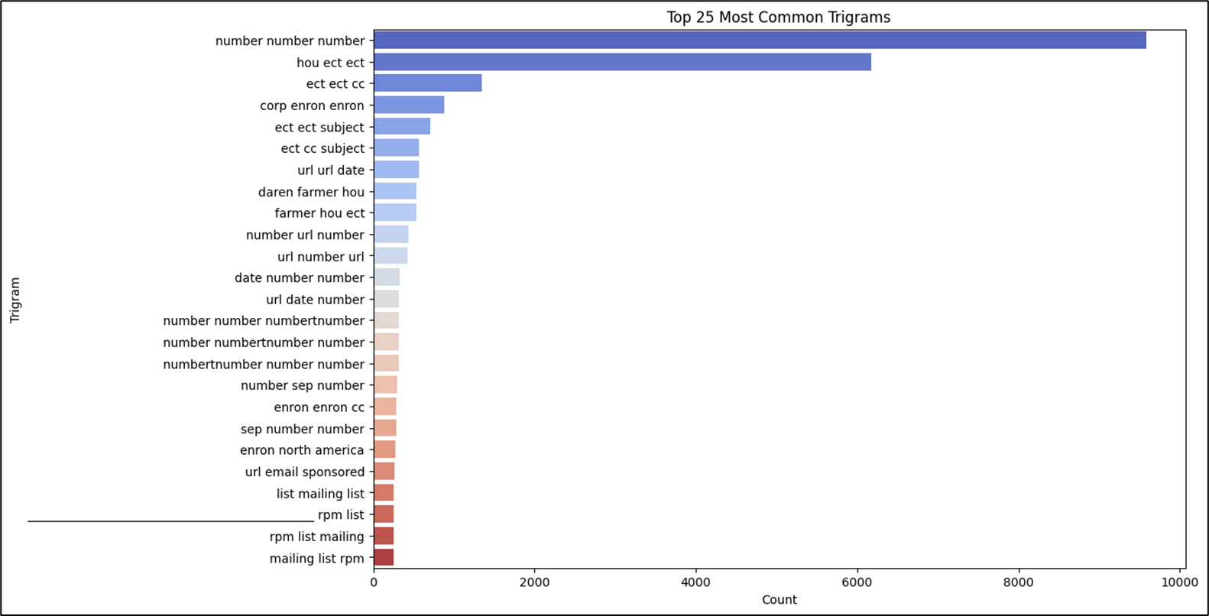
11
Top 25 Common Tri-grams

Slide 13
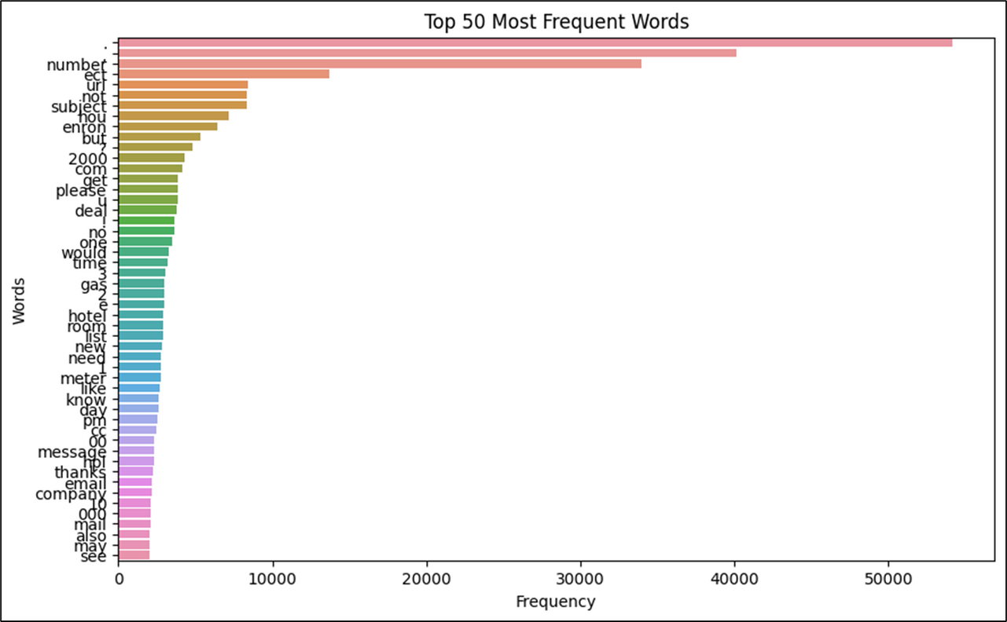
12
Top 25 Frequent Words

Slide 14
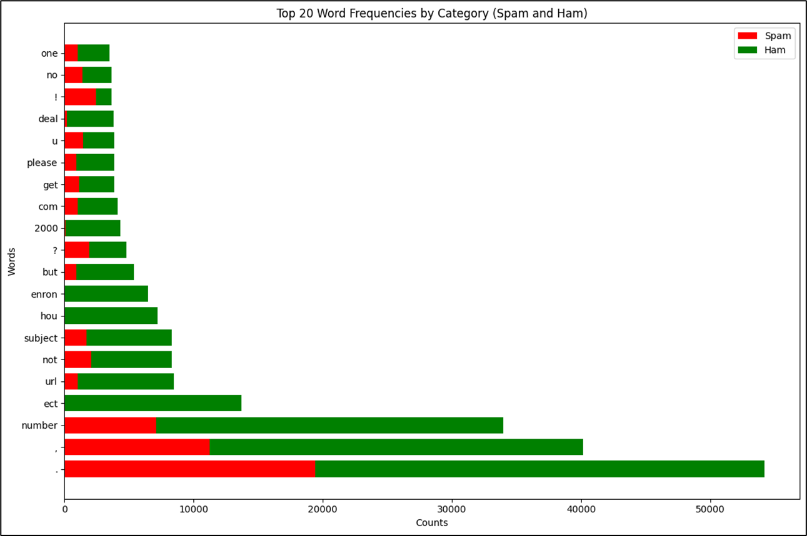
13
Top 20 Frequent Words by Category

Slide 15
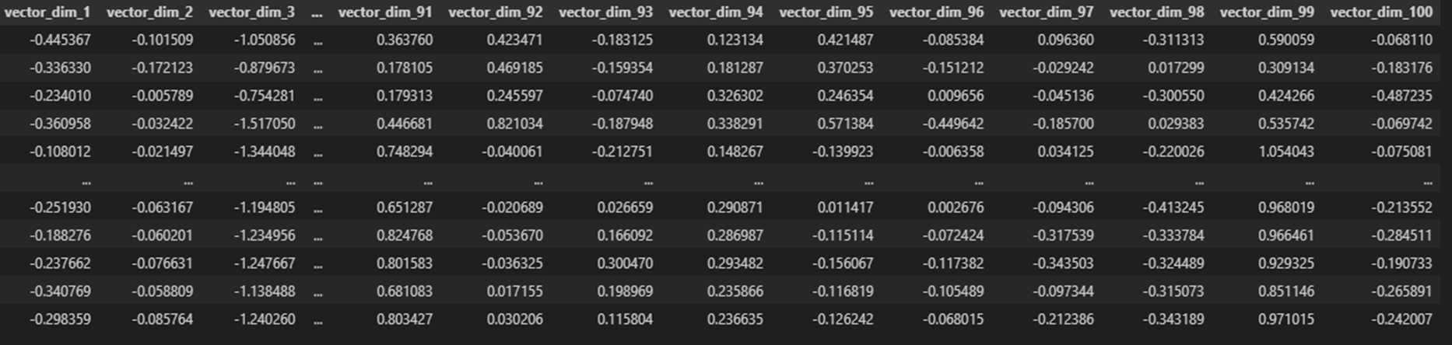
14
CONTEXTUAL EMBEDDING AND WORD2VEC
•Embedding: Used Word2Vec for generating 100-dimensional vectors.
•Purpose: Captures the semantic meaning of words, aiding in accurate classification.

Slide 16
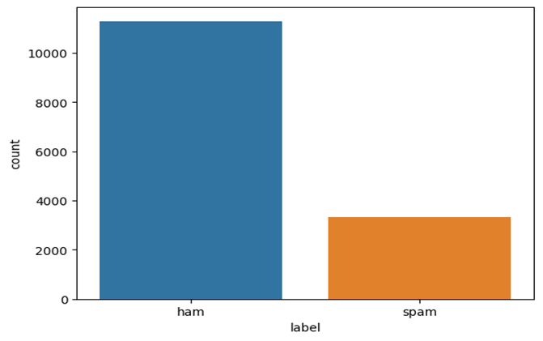
15
HANDLING IMBALANCED DATA
•Problem: Class imbalance common in spam classification.
•Solutions:
Undersampling: Reduced non-spam emails to balance classes.
Oversampling: Duplicated spam emails.
SMOTE: Created synthetic samples of spam emails for further balance

Slide 17
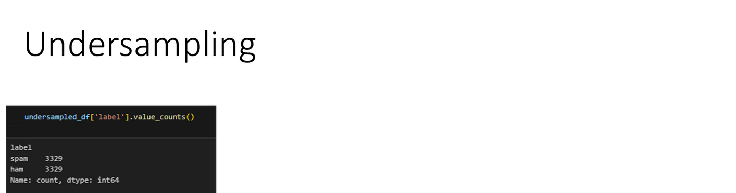
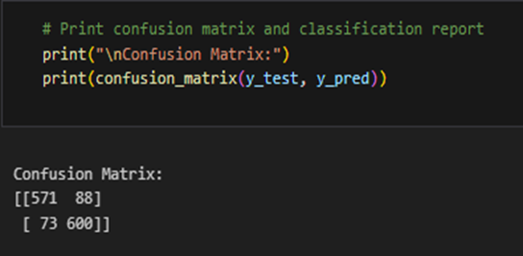
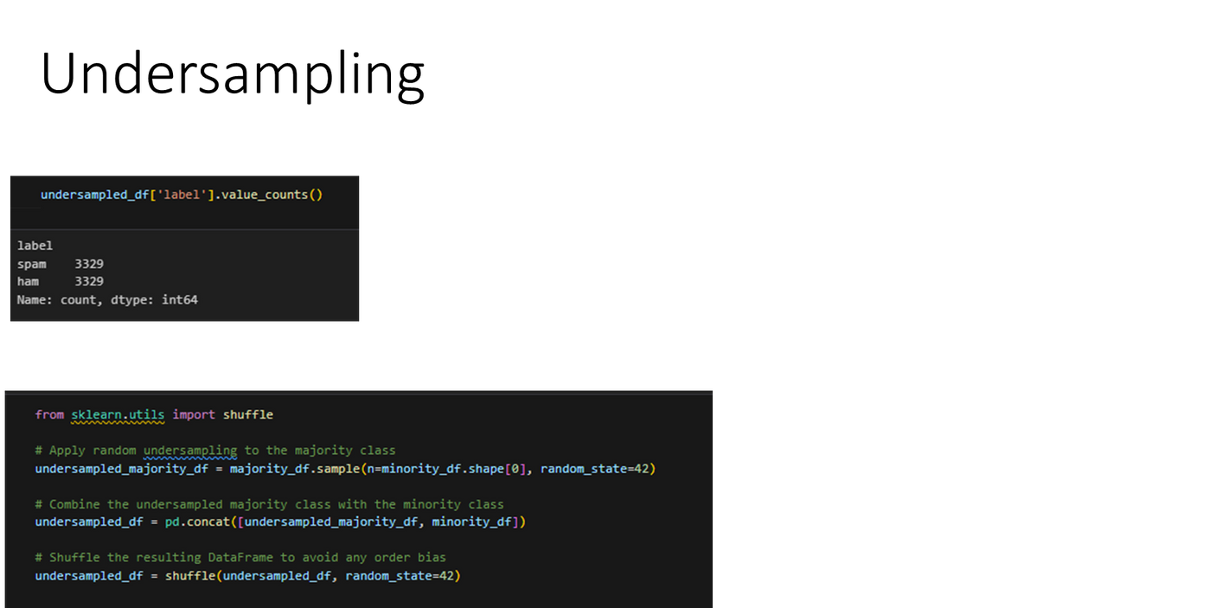
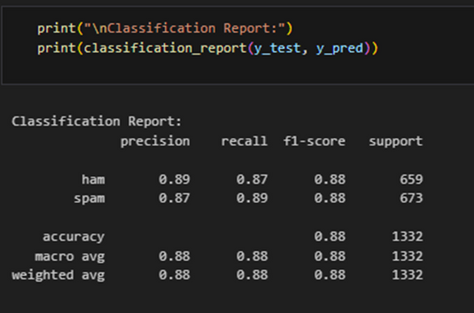
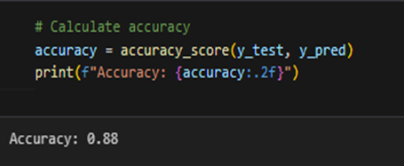
16
UNDERSAMPLING

Slide 18
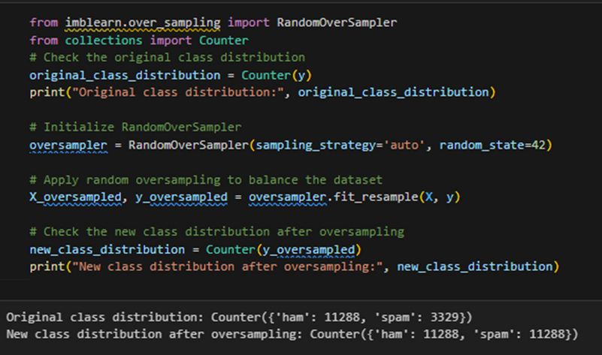
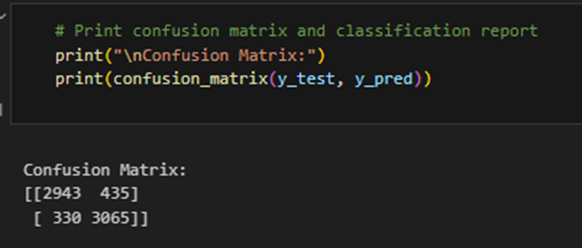
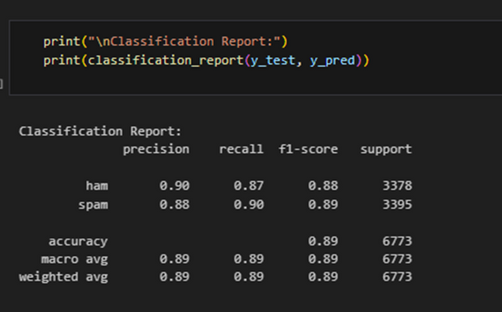
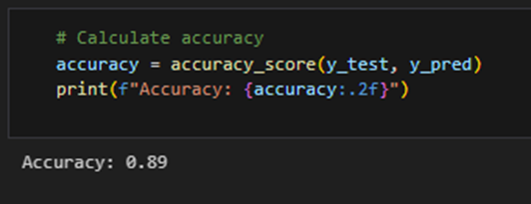
17
OVERSAMPLING

Slide 19
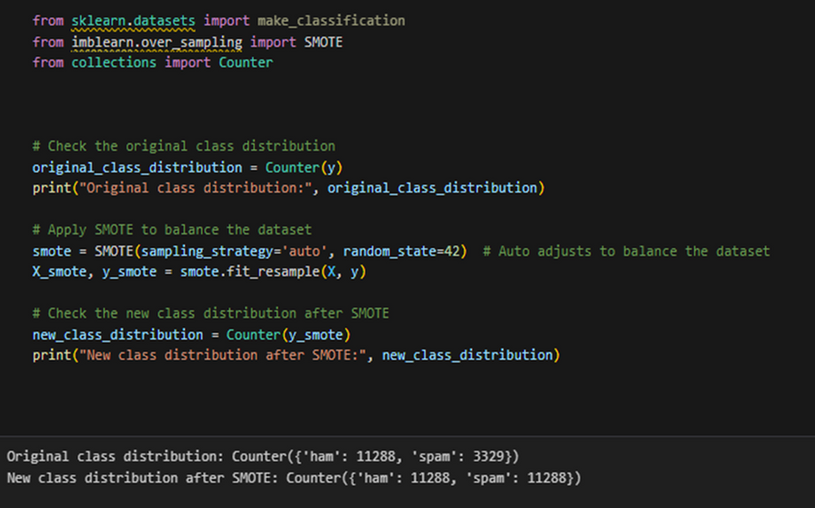
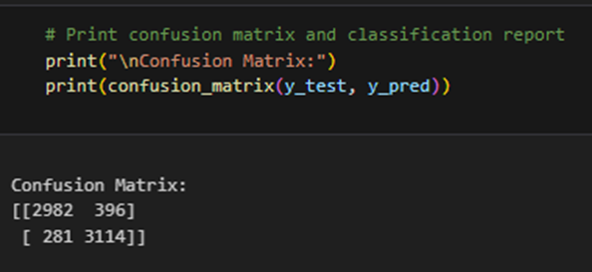
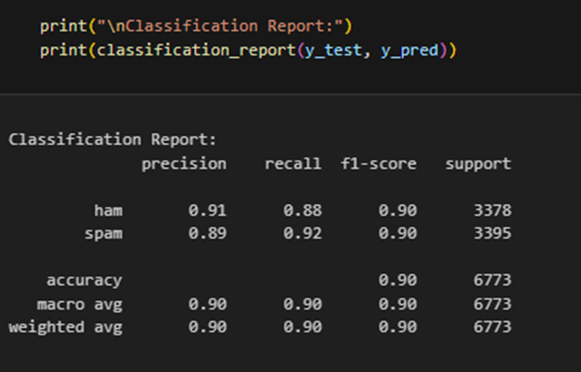
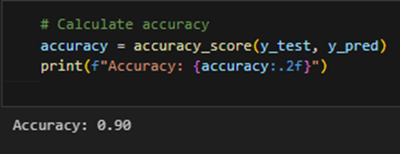
18
SMOTE

Slide 20
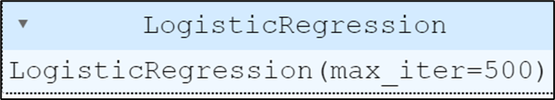
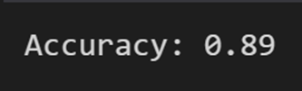
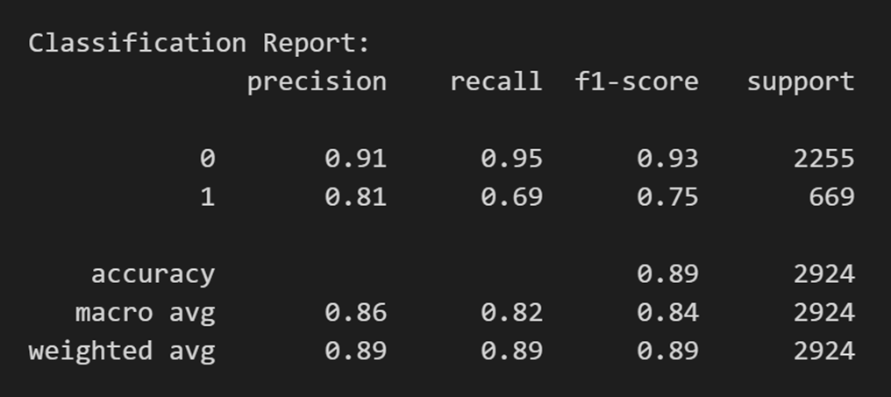
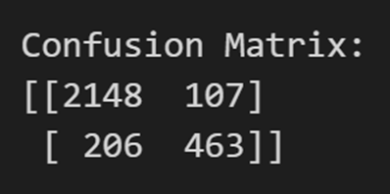
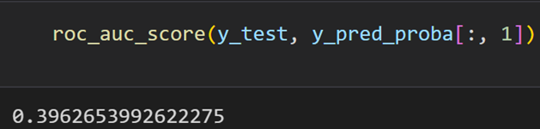
19
MODEL: 1
Accuracy
Classification Report
Confusion Matrix
AUC-ROC Score

Slide 21
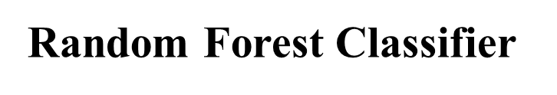
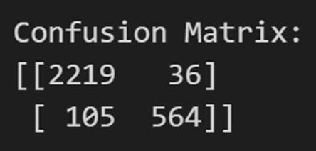
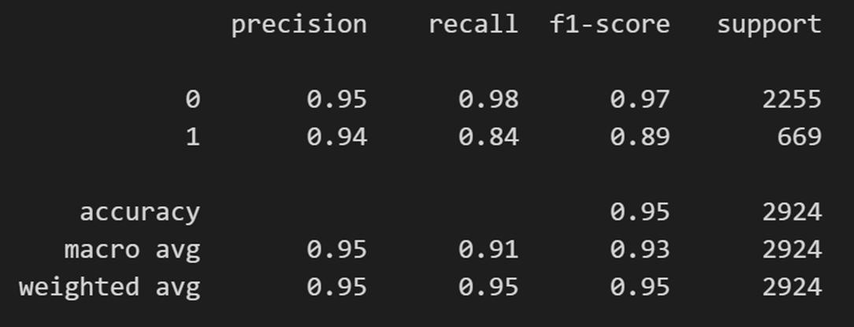
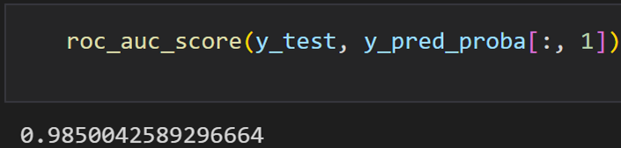
20
MODEL: 2
Classification Report
Confusion Matrix
AUC-ROC Score

Slide 22
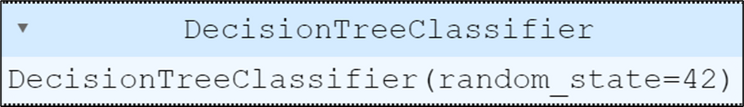
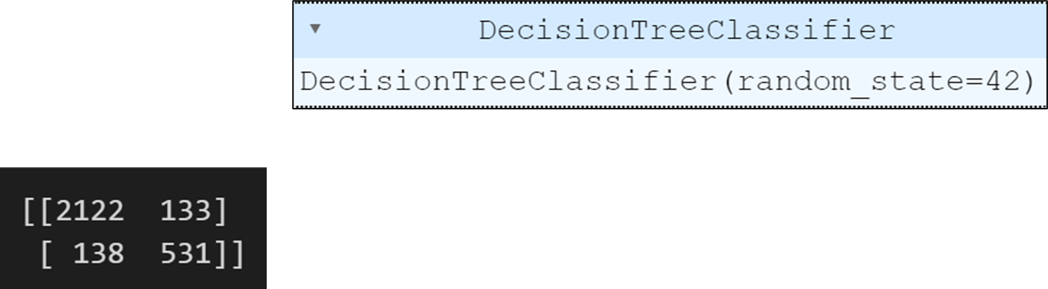
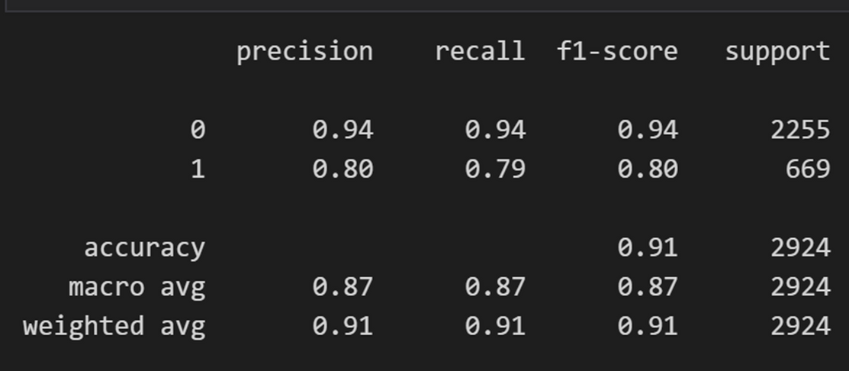
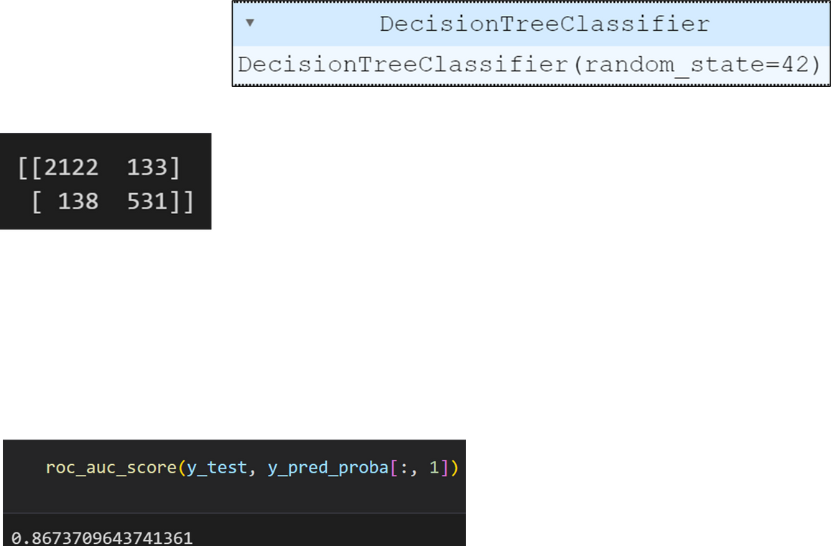
21
MODEL: 3
Classification Report
Confusion Matrix
AUC-ROC Score

Slide 23
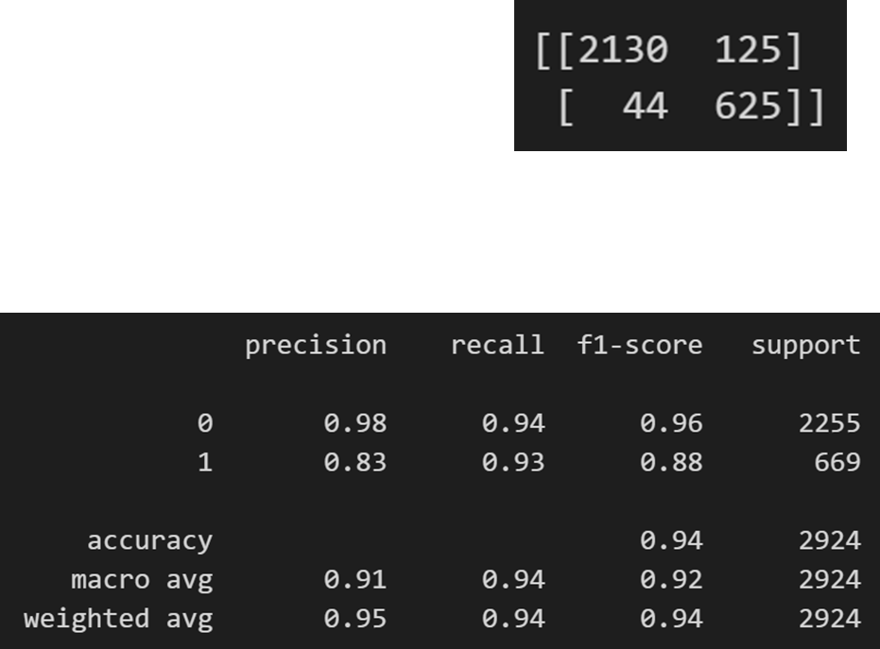
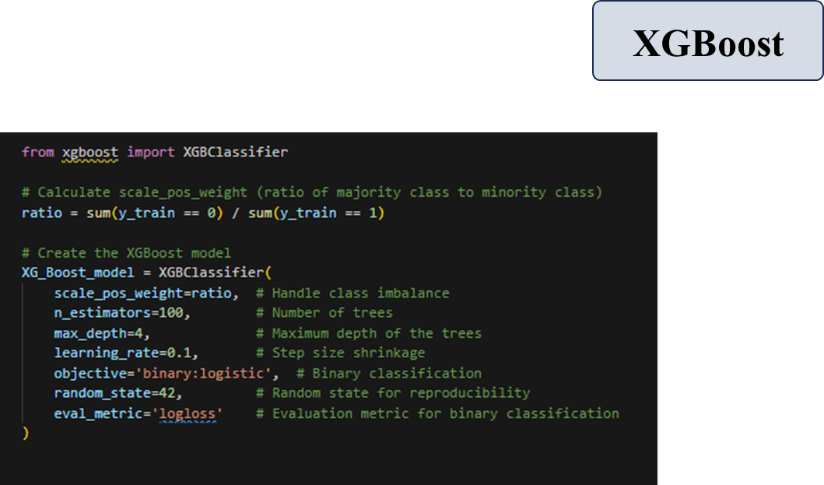
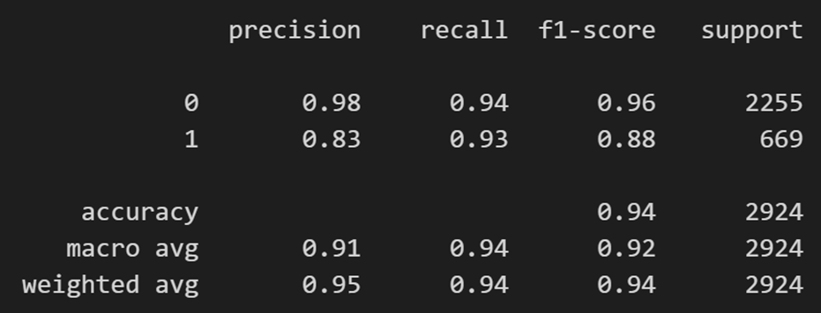
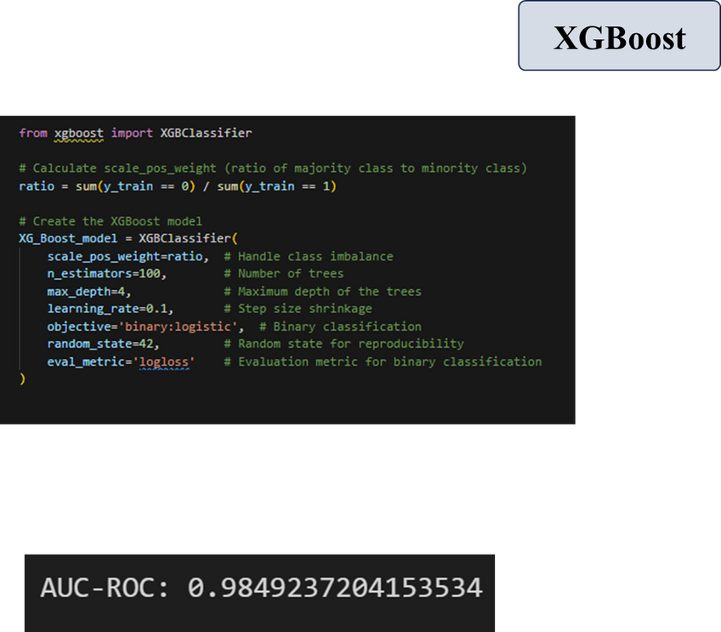
22
MODEL: 4
XG Boost
Confusion Matrix
Classification Report
AUC-ROC Score

Slide 24
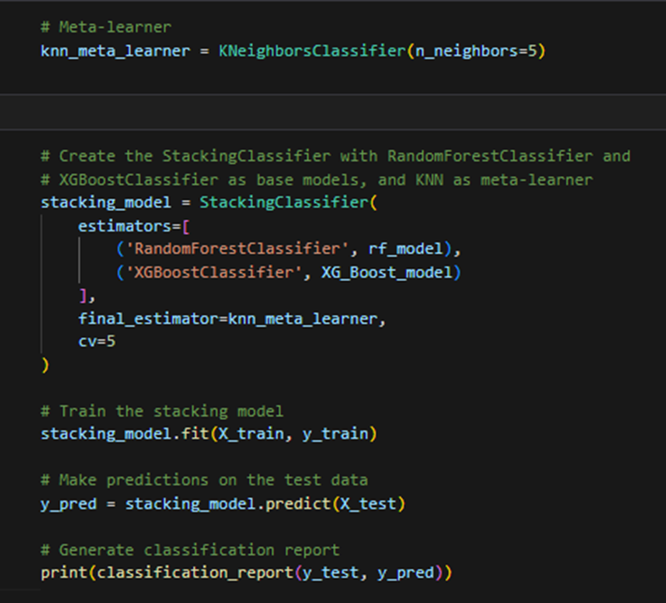


23
MODEL: 5
Confusion Matrix
Stacking
Classification Report

Slide 25

24
MODEL’S PERFORMANCE

Slide 26





25
HYPERPARAMETER TUNING
Best Model: Random Forest Classifier.

Slide 27


26
PREDICTION

Slide 28
THANK YOU

